Slide 1
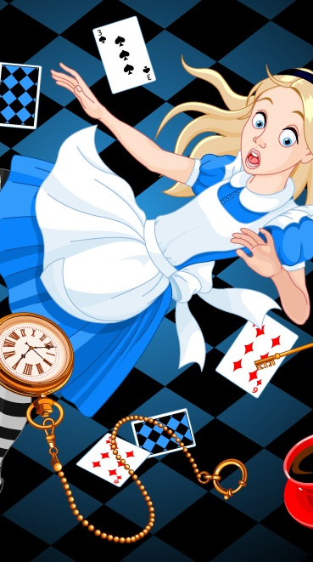

Portrayal of Mental Health Issues in Children’s Literature.
XXXXXXXXX

Slide 2
Mental illness is currently an issue that impacts younger children and is represented in characters in children's literature .Children's books have a negative impact on mental
illness due to how the characters are portrayed and described and each of these stories. ,Books such as Alice in the Wonderland and Charlie Brown depict signs and characters that deal with a type or multiple types of mental disorders. Children with mental illness should be educated on ways to cope with their sickness, not being judged for being different , or being taught and raised to believe they are the odd one out.

Slide 3
Children with mental illness should be educated on ways to cope with their sickness, not being judged for being different , or being taught and raised to believe they are the odd one out.
There are millions of people daily who get diagnosed with having a mental disorder daily. Some are born with these disorders and some people gradually develop them by dealing with and responding to traumatic events that occur in their life. I believe it’s very important no matter if the child has a mental disability or not that they should be able to understand and be educated on the whereabouts of these disorders.

Slide 4
Using children's literature to confront the stigma of mental illness in a positive manner.
Example 1:
Example 2:
Children's books have a negative impact on mental illness due to how the characters are portrayed and described and each of these stories .Children are not taught to view mental disabilities as a positive conversation. Most of the time parents and or legal guardians like to shy away or ignore the topic of talking and educating their children on mental health. To give an instance “ In this study, mental illness is identified as a disorder such as major depression, bipolar disorder, and schizophrenia [6]. Children of a parent with a mental illness (COPMI) are at higher risk of developing a mental health issue, compared to the same age [7]. Given the prevalence and risks for these children, it is important that there are appropriate and accessible supports and interventions available to them(MDPI)”.
Children are not taught to view mental disabilities as a positive conversation. Most of the time parents and or legal guardians like to shy away or ignore the topic of talking and educating their children on mental health. To give an instance “ In this study, mental illness is identified as a disorder such as major depression, bipolar disorder, and schizophrenia [6]. Children of a parent with a mental illness (COPMI) are at higher risk of developing a mental health issue, compared to the same age [7]. Given the prevalence and risks for these children, it is important that there are appropriate and accessible supports and interventions available to them(MDPI)”.

Slide 5
Children will start to believe that all these characters are crazy and start to view them in a negative way . Another example would be the most famous comic “Charlie Brown”, he is a gentle lovable insecure little boy , who always has an agenda to get an activity done but because of his overthinking and insecurities he never follows through with his plans. For example, “Charlie Brown is often ridiculed and taken advantage of by his peers. Charlie is often humiliated, resulting in constant usage of his two favorite words, "Good Grief!" This leads me to conclude that Charlie Brown was suffering from Avoidant Personality Disorder (ReelRundown). “ Due to this Charlie Brown always was sad and depressed and felt like he was always alone and too himself. It is vital for children to understand the concept and importance of mental disorders.

Slide 6
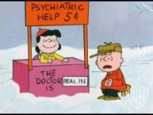
“Charlie Brown is often ridiculed and taken advantage of by his peers. Charlie is often humiliated, resulting in constant usage of his two favorite words, "Good Grief!" This leads me to conclude that Charlie Brown was suffering from Avoidant Personality Disorder (Reel Rundown)”.

Slide 7
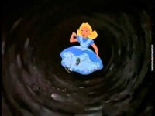
Alice in wonderland
Alice in wonderland , in this novel Alice is suffering from hallucinations and multiple personality disorders(Owlcation).” Each of the characters of this story are suffering or battling with a mental disease in some shape of form . The Mad Hatter has an “Obsessive-Compulsive disorder. He wants everything to go his way as planned. The White Rabbit is suffering from “Generalized Anxiety Disorder because he is going to be late for teatime, so he is always rushing. The Cheshire Cat is dealing with Schizophrenia because he is always appearing and disappearing and always seeing shadows and figures.

Slide 8
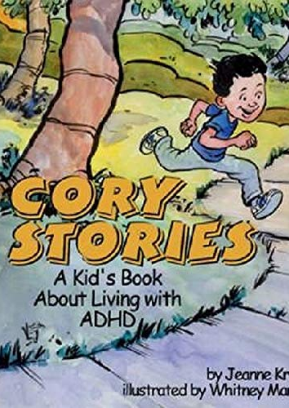
A Child who is living with adhd
Cory Stories: A Kid’s Book About Living With ADHD
Written by Jeanne Kraus, illustrated by Whitney Martin
Cory tells readers about himself in this picture book with black-and-white illustrations. Cory says that sometimes kids make fun of him, and he isn’t sure why. “Sometimes my whole body falls off the chair!” But readers also learn that Cory has persevered, concentrating in karate class, making friends at bowling club, and helping other kids with math. The important parting message: “Nobody needs to be good at everything. But I found out that I am good at a lot of things.”

Slide 9
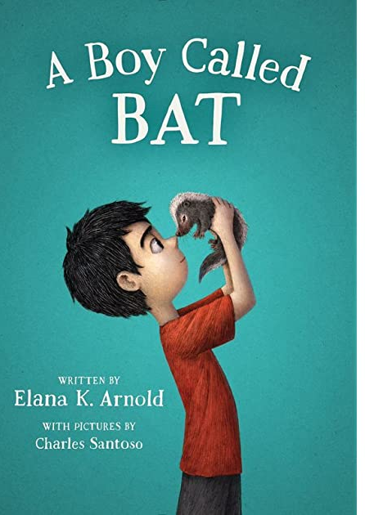
A Child who is living with autism
A Boy Called Bat
Written by Elana K. Arnold, illustrated by Charles Santoso
On the surface, it’s a sweet boy-wants-pet story. Bixby’s (aka Bat’s) mom is a veterinarian, and she brings home a baby skunk that he desperately wants to keep. But readers with autism may relate to chatter about itchy and uncomfortable clothes, sticking with routines, and only having friends who are grown-ups. “It does a wonderful job of describing the day-to-day experience of high-functioning children with ASD,” says an expert at the Child Mind Institute.

Slide 10
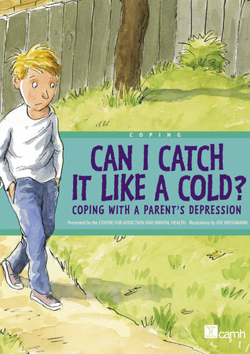
A child living with Depression
Can I Catch It Like a Cold? Coping With a Parent’s Depression
Written by the Centre for Addiction and Mental Health, illustrated by Joe Weissmann
Alex’s dad doesn’t work anymore and just wants to sleep all the time. When Alex finds out why — that he’s suffering from depression — he confides in his friend Anna. She tells him that her mom has depression too, and she sees a therapist to help her feel better. “I like that it promotes the benefits of therapy for the entire family,” says an expert at the Child Mind Institute.

Slide 11
Children are subject to judging those who have different qualities and characteristics than what they have. Children with mental illness should be educated on ways to cope with their sickness, not being judged for being different , or being taught and raised to believe they are the odd one out. children should be educated and have experience on knowing how to identify and work with someone who has a mental disability. As adults and teachers and leaders , we need to start spreading awareness on mental health and educating our children on it , and for it to be normalized in society that children can go through mental health issues and still be good citizens and to not be seen as unordinary.

Slide 12
WorkS Cited
“44 Children's Books about Mental Health.” Child Mind Institute, 27 July 2021, childmind.org/article/best-children-books-about-mental-health/.
Depictions of Mental Illness in Children's Media.” ResearchGate, www.researchgate.net/publication/232092981_Depictions_of_Mental_Illness_in Children's_Media.
Gypsum Girl. “Charlie Brown & Other Peanuts Characters' Personality Disorders.” ReelRundown, ReelRundown, 30 Jan. 2011, reelrundown.com/animation/A-Psyche-Analysis-of-Charlie-Brown-and-his- Friends.
Monetp. “Mental Health Representation in Literature.” RED INC., 19 Oct. 2018, su4roth.wordpress.com/2018/10/19/mental-health-representation-in-literature/.

Slide 13
WorkS Cited
Mukolo, Abraham, et al. “The Stigma of Childhood Mental Disorders: A Conceptual Framework.” Journal of the American Academy of Child and Adolescent Psychiatry, U.S. National Library of Medicine, Feb. 2010, www.ncbi.nlm.nih.gov/pmc/articles/PMC2904965/.
Prater, Mary Anne. “Learning Disabilities in Children's and Adolescent Literature: How Are Characters Portrayed? - Mary Anne Prater, 2003.” SAGE Journals, journals.sagepub.com/doi/abs/10.2307/1593684.
Riebschleger, Joanne, et al. “Mental Health Literacy Content for Children of Parents with a Mental Illness: Thematic Analysis of a Literature Review.” MDPI, Multidisciplinary Digital Publishing Institute, 26 Oct. 2017, www.mdpi.com/2076-3425/7/11/141/htm.
S, Molly. “Mental Illness in Alice in Wonderland.” Owlcation, Owlcation, 10 Mar. 2018, owlcation.com/humanities/Mental-Illness-in-Alice-in-Wonderland.

