Slide 1
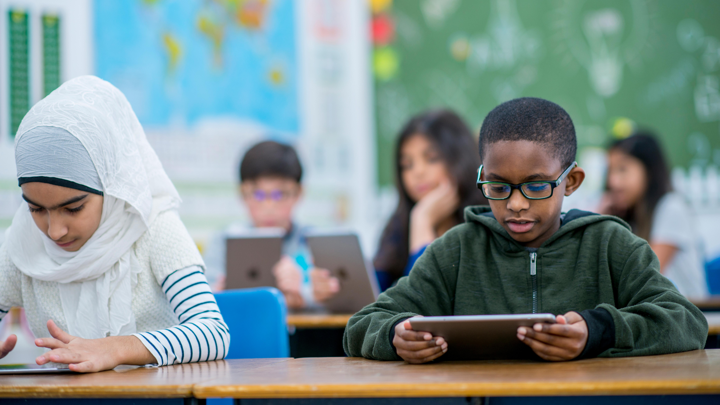
Gender Representation in Children’s books 2021
Created By XXXXXX
ENG 250 Children’s Literature

Slide 2
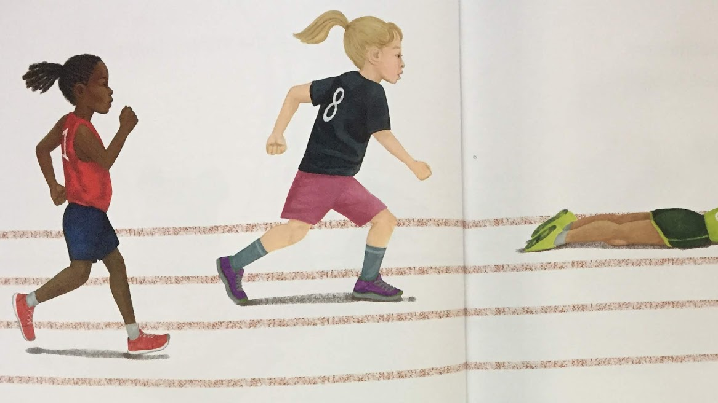
Changing world
As it has become more important to express who you are, as well as the rise of support of the LBGTQ+, children's literature is moving in a positive direction for inclusion and advocacy.
Gender defined by “roles” as well as the term “gender” is holding children back less frequently through advocacy initiatives.
I Am Enough by Grace Byers a creative picture book that tells the importance of respecting one another and the uniqueness within everyone. Books such as this grow a child's understanding of individualism.
Notes:
Hook**
Audio: In a quickly evolving world adults are not the only ones experiencing change. Children take in everything around them. Picking book that has equal gender representation has become easier in recent years as idenetity has become more important to society.

Slide 3
Equal gender representation takes the spotlight in children's literature
Children’s books are a form of education and entertainment for both children and adults. Unfortunately, in the past, there was a lack of equally shared roles and life goals between genders in children’s books.
Exclusion can lead to children to miss their full potential and may feel as if they are stuck within a box of gender roles (stereotypes).
In recent years as people have come to recognize the value and importance of equality as well as the impact that negative gender stereotypes have on children. These changes have created fresh motives and purpose for children’s literature.
This new viewpoint in children's literature is key, especially in our rapidly developing and diversifying society.
Notes:
Introduction**

Slide 4
Why is this so important?
Thesis: Children's books are now including a focus on cross-gender preferences and gender equality which allows for children to understand themselves and their role in society.
It is important to understand the developmental process of a child as many parents and guardian aren’t aware what takes place when a child is finding themselves.
This Photo by Unknown author is licensed under CC BY-NC.
Notes:
Thesis:
Children's books are now including a focus on cross-gender preferences and gender equality which allows for children to understand themselves and their role in society.

Slide 5
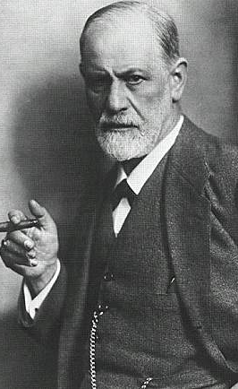
Within the mind of a child
Created by Sigmund Freud; Psychoanalysis which is in short, is the study of subconscious self-conflicts through things such as dreams.
Children develop their superego around first 3 years of life.
Freud also used this theory for children known as superego which is composed of two components.
The first is “Ego Ideal” also known as “ID” which refers to the standards of good behavior which leads to feelings of pride and if broken, can lead to the feeling of guilt.
The second component, “The Conscience” also known as “Super Ego” which is a complement of rules and behaviors that the child considers good or bad and how they respond to the situation emotionally.
“The superego is the component of personality composed of the internalized ideals that we have acquired from our parents and society.” (Biograghy.com Sigmund Freud)
This Photo by Unknown author is licensed under CC BY-NC-ND.
Notes:
Audio 2: The ID is where unconsouis urges and desires take place and Super Ego suppresses urges that the child finds morally and socially wrong this creates the child's ego which is their principle of reality.

Slide 6
Gender Identity
ID
Super Ego
Ego
By the age of five children have a sense of gender identity, this means the child can understand the gender roles in children’s books before they are able to read children’s books on their own.
At this stage in their life, it is common for children to be interested in cross-gender preferences which are interests in subjects that cross gender stereotypes. For example, girl being interested in hobbies that are commonly preferred by boys.
Cross gender preferences are healthy for children, as it allows them to understand gender diversity, in return increases social acceptance.
“Meanwhile, "gender identity" refers to an internal sense people have of who they are that comes from an interaction of biological traits, developmental influences, and environmental conditions.” (Cherry The importance of the superego in psychology)
Notes:
Audio: It is important to express to children at a young age it is okay to like things that is commonly enjoyed by another gender this is called cross-gender preferences which is an important step in a child’s development in themselves.

Slide 7
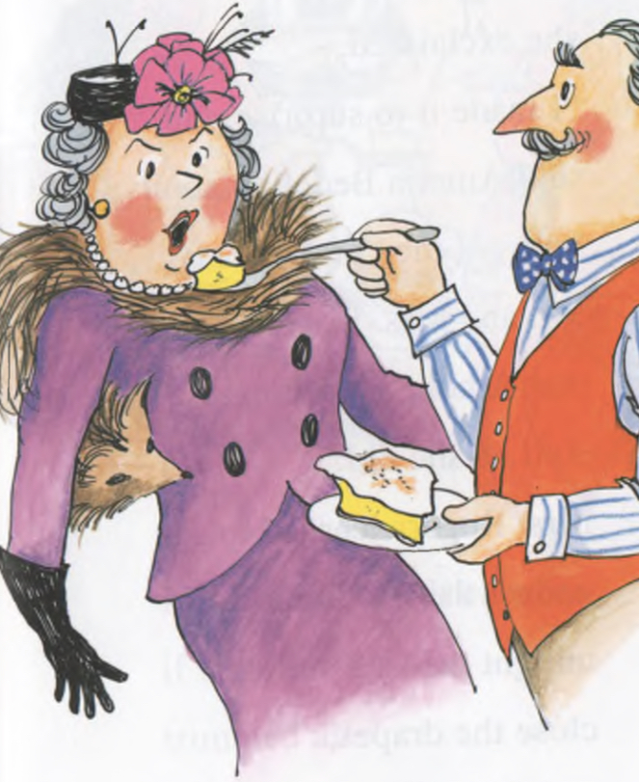
Minimal equal gender representation in children’s books in the past
In Amelia Bedelia written in 1963, a female maid is clumsy and is always messing up her chores or getting in trouble. One day the couple went on a day trip and left some chores for Amelia. Amelia did the chores all wrong, upsetting Mrs. Rodgers. When the wife was about to speak about the mess, she was silenced with a piece of pie by the man.
This shows the power men had over women which is not what we should be portraying to children as no one should be silenced or silence someone else.
Notes:
Book like Amelia Badlia show a male power that is not accurate to today’s society women have just as much power as men. Books like this can give your child a standard of behavior that can affect they way they look at themselves or others

Slide 8
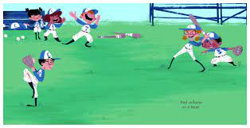
New age of books
Pink Is For Boys is a newer book published in 2018. This book shows integration of race, gender, and ethnicity as well as cross gender preferences.
This book expresses the joy of what you like and what you like doing no matter what others say or think. This book is about children doing what makes them happy and dismissing the stereotypes that are set in place. This encourages children to do what they love and not to fear liking different things.

Slide 9
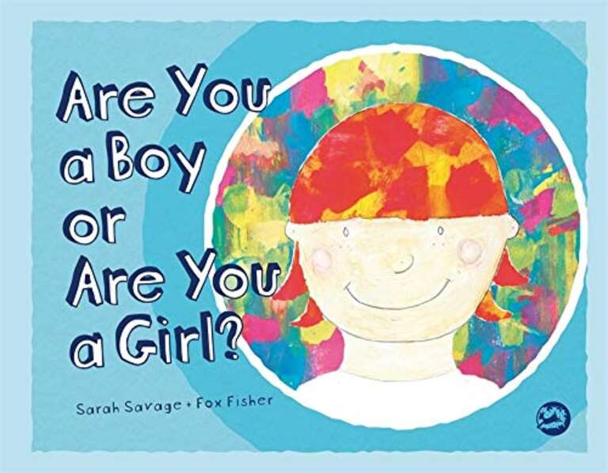
Other books that represent genders’ equally
Written by Sarah Savage and Fox Fisher, a child named Tiny likes dressing any which way but hates the question "Are you a girl or boy?" This book is a great intro into gender identity
Wiritten by Ibtihaj Muhammad, a young girl who wears her new ocean blue hijab must find new forms of strength as some of her classmates are not so kind.
Written by Craig Pomranz, a young boy who has an idea to make his father a scarf for his birthday even though the other kids think it is girly to knit. One day his talents are needed in the school pageant and the students notice how handy knitting is.

Slide 10
Why this change in literature is so important
“Children’s literature is important because it provides students with opportunities to respond to literature; it gives students appreciation about their own cultural heritage as well as those of others; it helps students develop emotional intelligence and creativity; it nurtures growth and development of the student’s personality and social skills” (Crippen The value of children's Literature: Oneota reading journal)
Children's literature provides fundamental attributes of Freud's theory of ego.
With the literature that is commonly produced focuses on equality and diverse interests allows for children to understand themselves and their interests better without feeling a sense of inferiority or doubt.
Books such as Pink Is For Boys children can explore their interests and respond to the literature in a meaningful fashion for their developing minds.

Slide 11
Exposure to the beauty of individualism
This new form of children's literature is important as it develops character and allows for children to find what their interests are and who they are as a person.
Children's literature is important as it gives the reader entertainment while they build their respect for themselves and others.
With books that show the equal rights between genders, anyone can have an interest in what they find appealing without having to worry that it’s the opposite gender.
“From the start of the 20th century, the idea of childhood as a decisive stage in character development took root, and with this the idea that disruptive behavior can be prevented by adapting a person’s environment to suit their needs when growing up ̶ creating an environment full of happiness, love, and understanding, where a child is met with tolerance and respect from adults.” (Olivier Children's literature as a means of social change)
Notes:
Audio: Allowing children to have exposure to all life has to give allows them to develop an understanding and are able to ask questions earlier in a safe environment. Questions such as “why does he/she have two mommy’s? ” questions like this are important to have as our country is becoming increasingly accepting of peoples preferences.

Slide 12
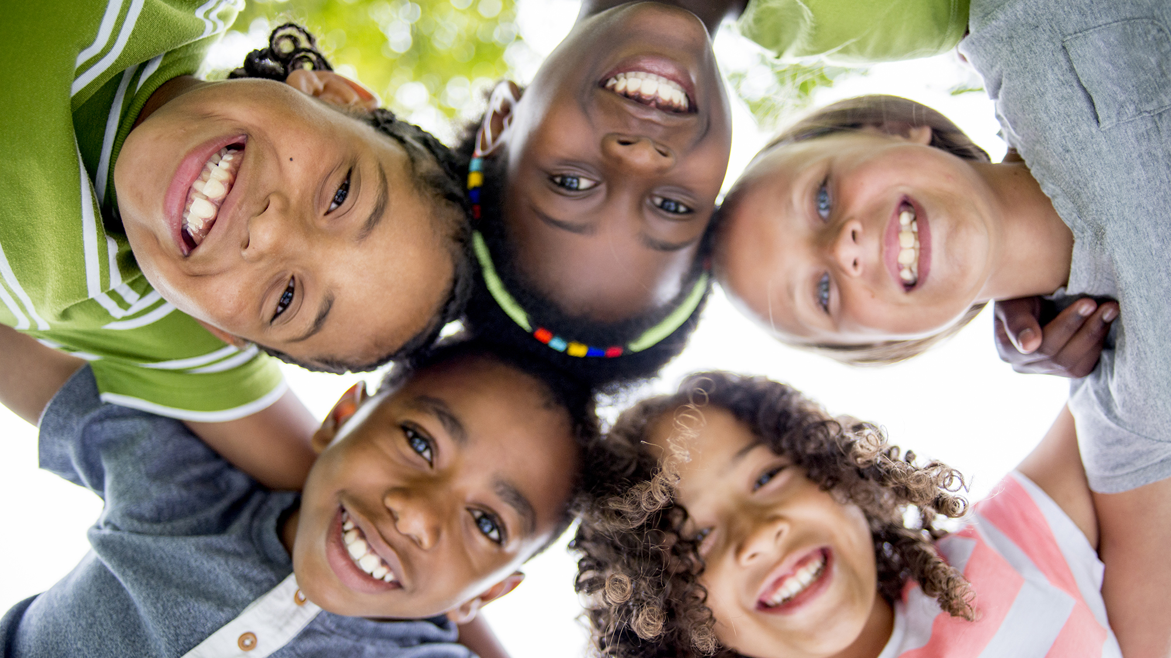
Conclusion
In conclusion, the development of these new books encourages children to gather a further understanding of themselves. Furthermore, they promote not being tied to specific roles and expectations that were in children's books from previous decades.
It is important that we focus on writing and buying books that support equal gender representation. This allows for children to find their ego in non-sexist and non-discriminatory books like many of us adults read as children.
This Photo by Unknown author is licensed under CC BY-SA-NC.

Slide 13
Work Cited
“9 Children's Books That Celebrate Gender Equality.” Edited by Save The Children, Save the Children, 2021, https://www.savethechildren.org/us/charity-stories/childrens-book-gender-equality.
Arribas, Ruben A. “Image of Sigmund Freud.” Aviones Desplumados, 2008, https://avionesdesplumados.blogspot.com/2008/05/sigmund-freud.html. Accessed 2021.
Cherry, Kendra. “The Importance of the Superego in Psychology.” Verywell Mind, Verywell Mind, 22 Apr. 2020, https://www.verywellmind.com/what-is-the-superego-2795876.
Crippen, Martha. “The Value of Children's Literature: Oneota Reading Journal.” Luther College, 2021, https://www.luther.edu/oneota-reading-journal/archive/2012/the-value-of-childrens-literature/.
“Gradeschool.” Edited by Healthychildren.org, HealthyChildren.org, American Academy of Pediatrics, 2021, https://www.healthychildren.org/English/ages-stages/gradeschool/Pages/default.aspx?fb_xd_fragment.
Ibtihaj, Muhammad, et al. The Proudest Blue: A Story of Hijab and Family. Andersen Press, 2020.

Slide 14
Work Cited Continued
Muhammad, Ibtihaj. “The Proudest Blue: A Story of Hijab and Family by Ibtihaj Muhammad - Audiobooks on Google Play.” Google Play, Google, Sept. 2019, https://play.google.com/store/audiobooks/details?id=AQAAAEAsGy1bEM&gl=US&hl=en-US&source=productsearch&utm_source=HA&utm_medium=SEM&utm_campaign=PLA&pcampaignid=MKT-FDR-na-us-1000189-Med-pla-bk-Evergreen-Jul1520-PLA-Audiobooks_Juvenile_Fiction&gclid=CjwKCAjwn8SLBhAyEiwAHNTJbWg5LvnatKjYNBi80UVTTcXFbRXMsib4rDkvpNp2QU6BvsN0OI-UVRoC_awQAvD_BwE&gclsrc=aw.ds.
Parish, P. (1963). In Amelia Bedelia. Harper and Row.
Pearlman , R. (2018). Pink Is For Boys. Running Press Book Publisher .v
Pomranz, Craig, and Margaret Chamberlain. Made by Raffi. Frances Lincoln Children's Books, 2015.
Raffterty, Jason. “Gender Identity Development in Children.” HealthyChildren.org, 2018, https://www.healthychildren.org/English/ages-stages/gradeschool/Pages/Gender-Identity-and-Gender-Confusion-In-Children.aspx.
Savage, Sarah, and Fox Fisher. Are You a Boy or Are You a Girl? Jessica Kingsley Publishers, 2017.

